Slide 1

Wafer Fault Detection

Slide 2
Team Members:
Rohit Salla
Ramya Manasa

Slide 3
Contents
Problem Statement
Description of Data
Application Architecture and module division
Techniques for Data Pre Processing
Literature Review
Deployment

Slide 4
Overview
Introduction
Problem Identification
Motivation
Literature Review
Inference from Literature Review
Research Contribution
Full stack Application
Conclusions and Scope for future work
References

Slide 5
Introduction
Semiconductor fabrication involves intricate procedures to produce integrated circuits (ICs) on wafers, playing a critical role in modern technology.
Faults or defects in wafers during manufacturing can lead to electronic devices malfunctioning or performing below expectations.
Manual fault detection is time-consuming and susceptible to errors, underscoring the need for automated solutions.
This project focuses on utilizing machine learning techniques to develop a robust system for detecting wafer faults, thereby improving manufacturing efficiency and product quality.

Slide 6
MOTIVATION
The motivation behind this project is the pursuit of enhancement in semiconductor manufacturing. By developing and implementing an effective wafer fault detection system, to contribute to the creation of reliable and efficient electronic devices.
Faulty wafers could result in compromised device reliability, increased manufacturing costs, delayed product launches, limited process optimization, and hindered technological progress. Our project strives to avoid these outcomes by proactively developing and implementing an effective fault detection system that safeguards the quality and reliability of electronic devices.

Slide 7
Problem Statement
To build a classification methodology to predict the quality of wafer sensors based on the given training data.
The goal is to build a Machine Learning model which predicts whether a wafer needs to be replaced or not (i.e., whether it is working or not) based on the inputs from various sensors.
There are two classes:
+1 represents Good Wafer
-1 represents Bad Wafer

Slide 8
Data Description :
There is a .csv file for Training and .csv file for prediction.
The client will send data in multiple sets of files in batches at a given location.
Data will contain Wafer names and columns of different sensor values for each wafer.
The last column will have the "Good/Bad" value for each wafer.
The "Good/Bad" column will have two unique values +1 and -1.

Slide 9
Literature Review
S.no | Techniques | Title of the Work | Results/ Limitations
1 | kNN and Naïve Bayes classifiers | Data-Driven Approach for Fault Detection and Diagnostic in Semiconductor Manufacturing | Identifying the key SVIDs accurately
2 | Image Processing and CNN | Review of Wafer Surface Defect Detection Methods | Wafer Surface Defect Detection Based on Image Signal Processing
3 | Deep Learning and Stacked Denoising Autoencoder | A Deep Learning Model for Robust Wafer Fault Monitoring With Sensor Measurement Noise | Measurement noise in sensors mounted on semiconductor manufacturing equipment
4 | k-Nearest Neighbours (k-NN) and SVM | Evaluation of the machine learning classifier in wafer defects classification | Established that Logistic Regression classifier is the best classifier to run a wafer defect detection
5 | K-NN | Silicon Wafer Fault Detection by using Multiple Data Prediction | Use of convolution neural networks in classifying wafer images

Slide 10
Literature Review
S.no | Techniques | Title of the Work | Results/ Limitations
6 | Optical Rule Check (ORC) with computation lithography . | Machine learning based wafer defect detection Yuansheng Ma, Feng Wang, Qian Xie, Le Hong, Joerg Mellmann, Yuyang Sun, Shao Wen Gao, Sonal Singh, Panneerselvam Venkatachalam, James Word | Most important techniques to flag potential failure patterns
7 | iCaRL is a learning algorithm that increases recognition types | Research on Wafer Surface Defect Pattern Detection Method Based on Incremental Learning | The model’s recognition accuracy of new defect categories and the ability to maintain old defect categories.
8 | An ensembled anomaly detector based on One Class Support Vector Machine (OCSVM) and Analysis of Variance (ANOVA). | An Ensembled Anomaly Detector for Wafer Fault Detection | to get advantages of both the multivariate (MVA) and univariate (UVA) analyses

Slide 11
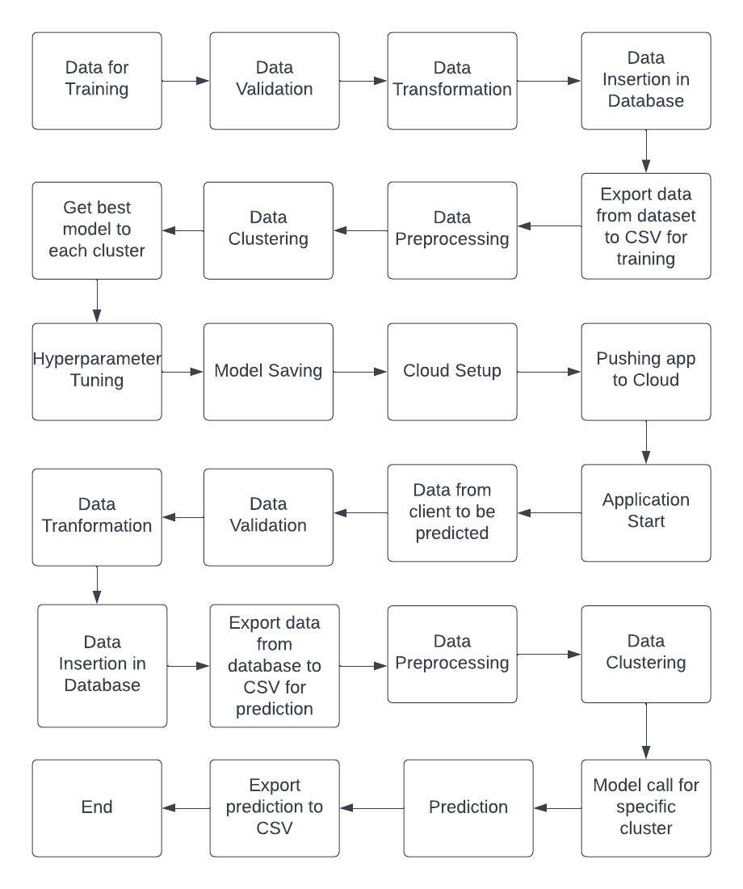
Architecture

Slide 12
Why K Nearest Neighbour Algorithm ?
High-Dimensional Data: In wafer fault detection, sensor data can result in high-dimensional feature spaces. KNN's performance can degrade as the dimensionality of the data increases, a problem known as the "curse of dimensionality."
Computational Complexity: KNN calculates distances to all training points for each prediction, making it computationally expensive for large datasets. This can impact real-time or near-real-time applications.
Sensitive to Noise and Outliers: KNN can be sensitive to noisy data or outliers. Faulty sensor readings or other anomalies could lead to misclassifications.

Slide 13
References :
Saqlain, M.; Jargalsaikhan, B.; Lee, J.Y. A Voting Ensemble Classifier for Wafer Map Defect Patterns Identification in Semiconductor Manufacturing. IEEE Trans. Semicond. Manuf. 2019, 32, 171–182. [CrossRef] 11. Chen, X.; Chen, J.; Han, X.; Zhao, C.; Zhang, D.; Zhu, K.; Su, Y. A Light-Weighted CNN Model for Wafer Structural Defect Detection. IEEE Access 2020, 8, 24006– 24018. [CrossRef]
Jicong Fan, Wei Wang, and Haijun Zhang. Autoencoder based high-dimensional data fault detection system. In Proceedings - 2017 IEEE 15th International Conference on Industrial Informatics, INDIN 2017, pages 1001–1006. Institute of Electrical and Electronics Engineers, Nov. 2017.
E. Kim, S. Cho, B. Lee, and M. Cho. Fault detection and diagnosis using selfattentive convolutional neural networks for variable-length sensor data in semiconductor manufacturing. IEEE Transactions on Semiconductor Manufacturing, 32(3):302–309, 2019.
Ding Li, Donghui Li, Chengdong Li, Lin Li, and Long Gao. A novel datatemporal attention network based strategy for fault diagnosis of chiller sensors. Energy and Buildings, 198:377 – 394, 2019.
A. Pol, V. Berger, C. Germain, G. Cerminara, and M. Pierini. Anomaly detection with conditional variational autoencoders. In 2019 18th IEEE International Conference On Machine Learning And Applications (ICMLA), pages 1651–1657, 2019.
Jae Wan Yang, Young Doo Lee, and In Soo Koo. Convolutional autoencoderbased sensor fault classification. In International Conference on Ubiquitous and Future Networks, ICUFN, volume 2018-July, pages 865–867. IEEE Computer Society, Aug. 2018.

Slide 14
Techniques used for Data Pre-Processing:
Null values are checked. If Null values are present, then they are imputed using KNN Imputer.
Columns having zero standard deviation were removed, as they don’t give any information during model training.
Unnecessary columns were removed during training like Wafer's name.

Slide 15
Model Training
Data Export from Db - The data in a stored database is exported as a CSV file to be used for model training.
Data Pre-processing
a) Check for null values in the columns. If present, impute the null values using the KNN imputer.
b) Check if any column has zero standard deviation, remove such columns as they don't give any information during model training.

Slide 16
Clustering - KMeans algorithm is used to create clusters in the pre-processed data. The optimum number of clusters is selected by plotting the elbow plot, and for the dynamic selection of the number of clusters, we are using the "KneeLocator" function. The idea behind clustering is to implement different algorithms
To train data in different clusters. The KMeans model is trained over pre-processed data and the model is saved for further use in prediction.

Slide 17
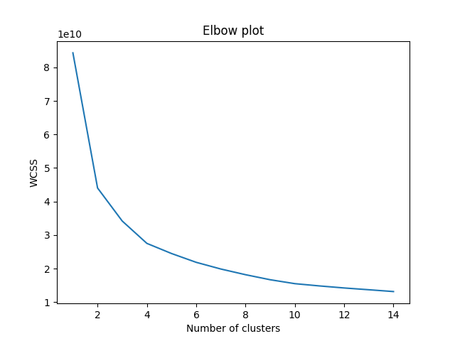
Elbow Plot for Selecting Optimal number of Clusters
To determine the optimal number of clusters, we have to select the value of k at the “elbow” i.e the point after which the distortion/inertia starts decreasing in a linear fashion. Thus for the given data, we conclude that the optimal number of clusters for the data is 4.

Slide 18
Model Selection
After clusters are created, we find the best model for each cluster. We are using two algorithms, "Random Forest" and "XGBoost". For each cluster, both the algorithms are passed with the best parameters derived from Grid Search.
We calculate the AUC scores for both models and select the model with the best score. Similarly, the model is selected for each cluster. All the models for every cluster are saved for use in prediction.

Slide 19
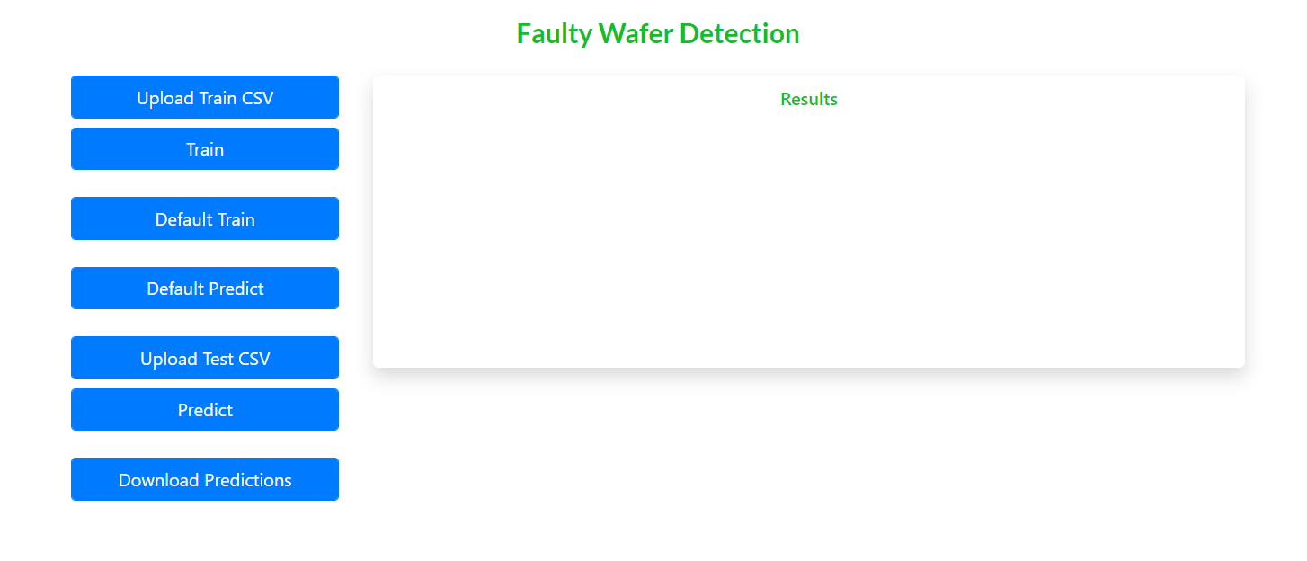
User Interface

Slide 20
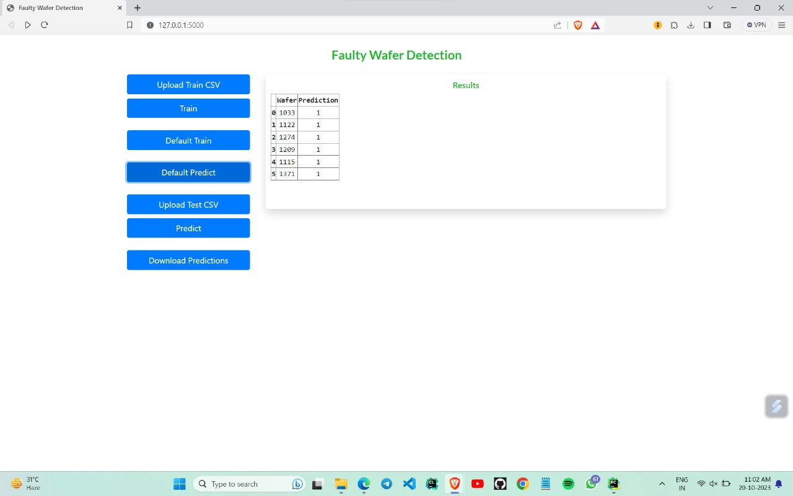
Result

